Slide 1
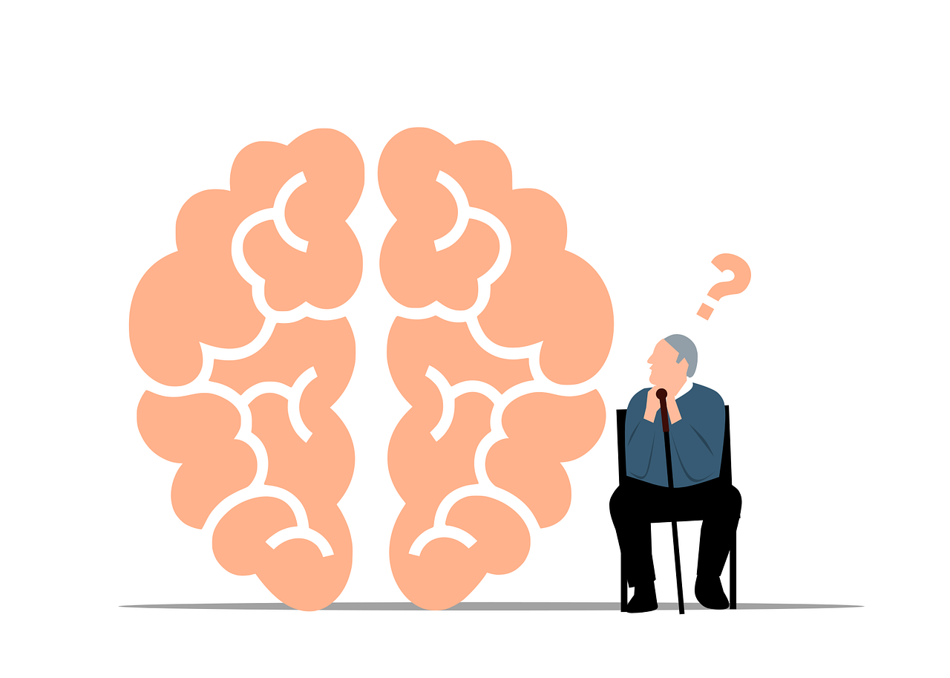
Design of a CNN–Swin Transformer Model for Alzheimer’s Disease Prediction Using MRI Images

Slide 2
TABLE OF CONTENTS
Project Description
Problem Statement
Objective
Scope
Significant
Existing System
Proposed System
Architecture
Resource Requirements
Research Gap analysis
Literature Survey
Implementation
Model Implementation
1. Algorithm Definition
2. working Process
✓ UMLs
✓ Results
✓ Conclusion
✓ References

Slide 3
PROJECT DESCRIPTION
This project presents a hybrid deep learning model that combines Convolutional Neural Networks (CNN) and Transformer architectures for classifying Alzheimer’s disease stages using MRI images. The proposed framework integrates the strengths of CNN-based models such as EfficientNet-B3, ResNet-50, and DenseNet-121 with advanced attention mechanisms from Swin Transformer, and Transformer Encoder. Each fusion model is trained to categorize MRI scans into five classes: Irrelevant, Mild Impairment, Moderate Impairment, No Impairment, and Very Mild Impairment. The CNN component captures spatial and hierarchical image features, while the Transformer component enhances contextual learning and long-range dependency extraction. A Flask-based application is developed to provide modules such as Home, Register, Login, Classification, and Logout, ensuring a complete system workflow. The integration of CNNs and Transformers demonstrates a balanced approach that improves classification performance and enhances feature representation.
Keywords: CNN, Swin Transformer, Alzheimer’s disease, MRI, Deep Learning, EfficientNet, ResNet, , DenseNet, Vision Transformer

Slide 4
PROBLEM STATEMENT
Conventional deep learning models used for MRI image classification face difficulties in capturing both local spatial patterns and global contextual dependencies. CNN models, although powerful for feature extraction, tend to lose global information as network depth increases. Transformer models, on the other hand, are effective at modeling long-range dependencies but require large datasets and high computational resources. There is a lack of a balanced hybrid architecture that effectively combines these advantages while maintaining computational efficiency. The problem addressed in this project is to design a CNN–Swin Transformer–based model capable of accurately predicting Alzheimer’s disease stages from MRI images across five predefined classes, ensuring improved accuracy, stability, and efficient feature representation.

Slide 5
OBJECTIVE OF PROJECT
The main objective of this project is to design and evaluate a hybrid CNN–Swin Transformer architecture for accurate classification of Alzheimer’s disease stages using MRI images. Specific objectives include:
To preprocess and standardize MRI image data for effective model training.
To develop four hybrid architectures integrating CNN and Transformer models—EfficientNet-B3 + Swin Transformer, ResNet-50 + Swin Transformer, , and DenseNet-121 + Transformer Encoder.
To extract spatial and contextual features effectively through the combined strengths of convolution and self-attention mechanisms.
To implement a Flask-based web application for classification with modules for Home, Register, Login, Classification, and Logout.
To evaluate model performance using various metrics and identify the most efficient architecture.

Slide 6
SCOPE
The scope of this project includes the design, development, and evaluation of hybrid deep learning models combining CNN and Transformer architectures for Alzheimer’s disease stage prediction. The models explored—EfficientNet-B3 + Swin Transformer, ResNet-50 + Swin Transformer, and DenseNet-121 + Transformer Encoder—focus on extracting rich spatial and contextual features from MRI datasets. The project aims to create an integrated system that performs data preprocessing, feature learning, classification, and output visualization. The developed Flask-based application provides modules such as Home, Register, Login, Classification, and Logout for smooth workflow management. The scope extends to comparing the performance of multiple hybrid architectures based on accuracy, precision, recall, and computational efficiency. However, the project focuses exclusively on MRI image-based prediction within the provided dataset and does not include multi-modal or real-time medical data integration.

Slide 7
SIGNIFICANCE OF PROJECT
The scope of this project includes the design, development, and evaluation of hybrid deep learning models combining CNN and Transformer architectures for Alzheimer’s disease stage prediction. The models explored—EfficientNet-B3 + Swin Transformer, ResNet-50 + Swin Transformer, and DenseNet-121 + Transformer Encoder—focus on extracting rich spatial and contextual features from MRI datasets. The project aims to create an integrated system that performs data preprocessing, feature learning, classification, and output visualization. The developed Flask-based application provides modules such as Home, Register, Login, Classification, and Logout for smooth workflow management. The scope extends to comparing the performance of multiple hybrid architectures based on accuracy, precision, recall, and computational efficiency. However, the project focuses exclusively on MRI image-based prediction within the provided dataset and does not include multi-modal or real-time medical data integration.

Slide 8
EXISTING SYSTEM
In the existing system, traditional deep learning models such as VGG16, AlexNet, and ResNet are commonly used for MRI image classification. These models rely mainly on convolutional layers to extract spatial features from the images. While CNN-based methods have achieved good results in medical image analysis, they often depend on deep hierarchical structures that focus only on local features. The models process each image in fixed receptive fields, which limits their ability to capture global dependencies and relationships across distant regions of the brain. As a result, these networks may fail to identify subtle variations that indicate different stages of Alzheimer’s disease. Furthermore, their performance is highly dependent on dataset size, data quality, and fine-tuning strategies, which restrict overall accuracy and generalization.

Slide 9
Disadvantages of Existing System
· Limited ability to capture global contextual information
· Performance decreases with small or imbalanced datasets
· High dependency on complex feature engineering
· Difficulty in identifying subtle stage variations
· Limited adaptability to varying MRI patterns
· Higher chances of overfitting in deeper networks
· Less interpretability of learned features

Slide 10
PROPOSED SYSTEM
The proposed system introduces a hybrid CNN–Transformer model for Alzheimer’s disease stage prediction using MRI images. Unlike traditional CNN models, this system combines convolutional networks (EfficientNet-B3, ResNet-50,DenseNet-121) with attention-based Transformer models (Swin Transformer, Vision Transformer, Transformer Encoder). The CNN part efficiently extracts spatial and hierarchical features from MRI images, while the Transformer component captures global dependencies and contextual relationships between distant regions in the brain.
The system classifies MRI images into five categories: Irrelevant, Very Mild Impairment, Mild Impairment, Moderate Impairment, and No Impairment. A Flask-based interface is developed to allow structured workflow with modules like Home, Register, Login, Classification, and Logout. By combining the strengths of CNNs and Transformers, the proposed system improves feature representation, enhances prediction accuracy, and reduces misclassification of subtle disease stages.

Slide 11
Advantages of Proposed System
· Captures both local and global features effectively
· Higher classification accuracy compared to traditional models
· Better performance with small or imbalanced datasets
· Efficient classification of subtle variations between Alzheimer’s stages
·Improved generalization and stability across MRI images
· Reduced overfitting in deep networks
· Structured workflow through Flask-based application modules

Slide 12
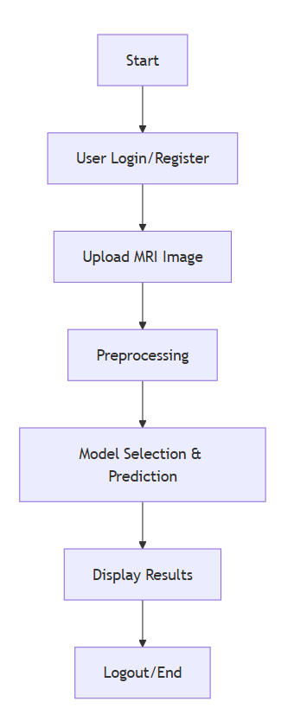
PROJECT FLOW

Slide 13
Resource Requirements
S/W CONFIGURATION:
H/W CONFIGURATION:
Processor - I3/Intel Processor
Hard Disk - 160GB
Key Board - Standard Windows Keyboard
Mouse - Two or Three Button Mouse
Monitor - SVGA
RAM - 8GB
Operating System : Windows 7/8/10
Programming Language : Python
Libraries : Pandas, Numpy, scikit-learn.
IDE/Workbench : Visual Studio Code.

Slide 14
RESEARCH GAP ANALYSIS
Alzheimer’s disease is a progressive neurodegenerative disorder, and early detection is critical for effective management. Existing research primarily focuses on traditional machine learning and classical CNN models for MRI-based Alzheimer’s classification. While these approaches achieve moderate accuracy, they often face challenges in capturing both local and global contextual features from MRI scans. Many models rely solely on CNNs, which excel at extracting local spatial patterns but may struggle to identify long-range dependencies and subtle changes in brain regions.
Furthermore, most prior studies have focused on binary or three-class classification of Alzheimer’s stages, limiting their applicability in real-world scenarios where multi-stage prediction is crucial. Datasets used in earlier works are often small, preprocessed differently, or lack sufficient diversity, affecting model generalization. Additionally, few studies integrate user-friendly interfaces for practical deployment, and explainability of the predictions is rarely addressed, reducing trust in automated systems for clinical use.

Slide 15
RESEARCH GAP ANALYSIS
Our project addresses these gaps by combining CNN architectures (EfficientNet-B3, ResNet-50, , DenseNet-121) with attention-based Transformer models such as Swin Transformer and Vision Transformer. This hybrid approach captures both fine-grained local features and global contextual dependencies, improving multi-class Alzheimer’s stage classification. Moreover, the system is developed with a web-based interface using Flask, allowing users to upload MRI images and view predictions interactively. Preprocessing techniques such as resizing, normalization, and augmentation ensure high-quality input data for robust model performance.
By addressing limitations in feature extraction, multi-stage classification, and usability, this project bridges a significant research gap in automated Alzheimer’s disease prediction, providing a more accurate, interpretable, and practical solution for medical imaging applications.

Slide 16
LITERATURE SURVEY
Year | Author(s) | Title | Outcome
2023 | Zhang et al. | Hybrid CNN-Transformer for Alzheimer’s Classification | Improved multi-class classification accuracy using combined CNN and Transformer features
2022 | Kumar et al. | MRI-Based Alzheimer’s Detection Using EfficientNet | Demonstrated robust feature extraction and high accuracy with EfficientNet on MRI datasets
2023 | Li et al. | Vision Transformer for Brain Disease Prediction | Showed that Transformers can capture global dependencies better than conventional CNNs
2024 | Sharma et al. | Multi-Stage Alzheimer’s Detection Using DenseNet | Achieved accurate classification across multiple stages and improved generalization

Slide 17
IMPLEMENTATION
Algorithm Definitions:
1. EfficientNet-B3 + Swin Transformer
This hybrid model first uses EfficientNet-B3 to extract local features from MRI images efficiently using depthwise separable convolutions. The extracted feature maps are passed to the Swin Transformer, which captures global contextual dependencies using shifted window-based attention. Finally, a classification head predicts the Alzheimer’s disease stage. The combination improves accuracy by leveraging both local and global representations.
2. ResNet-50 + Swin Transformer
The ResNet-50 backbone extracts hierarchical features from MRI images using residual connections to prevent vanishing gradients. The Swin Transformer then models long-range dependencies across feature maps. A fully connected layer outputs predictions for Alzheimer’s stages. This hybrid model enhances feature richness and stability for multi-class classification.

Slide 18
IMPLEMENTATION
Algorithm Definitions:
3. DenseNet-121 + Transformer Encoder
DenseNet-121 extracts features while maintaining efficient connectivity between layers to reuse feature maps. The output feature maps are passed to a Transformer Encoder, which models relationships between different brain regions. The encoder output is fed to a classification layer for Alzheimer’s stage prediction. This model emphasizes feature reuse and long-range dependency modeling.

Slide 19
Dataset Collection
MRI images categorized into: No Impairment, Very Mild, Mild, Moderate, Irrelevant.
Images collected and organized for preprocessing.
Data Preprocessing
Resize images to uniform dimensions.
Normalize pixel values for consistency.
Apply data augmentation (rotation, flipping, scaling) to improve model robustness.
Model Selection & Training
Four hybrid models used:
EfficientNet-B3 + Swin Transformer
ResNet-50 + Swin Transformer
+ Vision Transformer (ViT) Fusion
DenseNet-121 + Transformer Encoder
Models trained on preprocessed MRI images to classify Alzheimer’s stages.

Slide 20
Feature Extraction & Classification
CNN backbones extract local features.
Transformer modules capture global dependencies.
Fully connected layers output multi-class predictions.
Evaluation Metrics
Accuracy, Precision, Recall, F1-score computed on test data.
Web-based Deployment
Flask framework used for backend.
HTML, CSS, JS for front-end UI.
Users can register, login, upload MRI images, and view predictions.

Slide 21
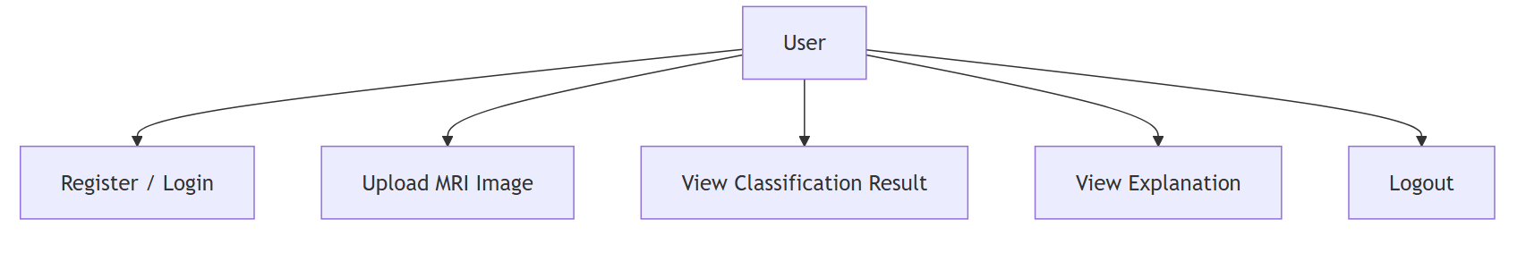
USECASE DIAGRAM
A use case diagram is a visual representation of the functional requirements of a system, showing the interactions between users (actors) and the system through use cases. It helps to identify the system's functionality and the actors involved.

Slide 22
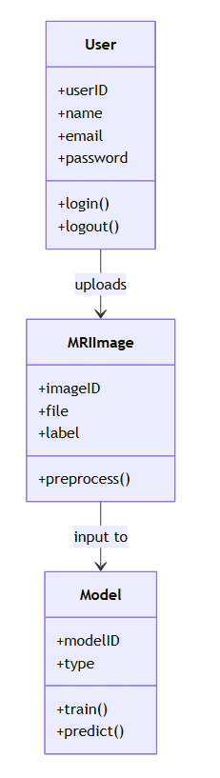
CLASS DIAGRAM
A class diagram is a static structure diagram that represents the system's classes, their attributes, methods, and the relationships between them. It provides a detailed view of the system's data structure and how different classes interact. Class diagrams are essential for object-oriented design and implementation.

Slide 23
SEQUENCE DIAGRAM
A sequence diagram is a behavioral diagram that illustrates how objects interact in a particular sequence of events over time. It shows the order of messages exchanged between objects and their interactions to fulfill a specific scenario or process. This diagram helps in understanding the dynamic behavior of the system.

Slide 24
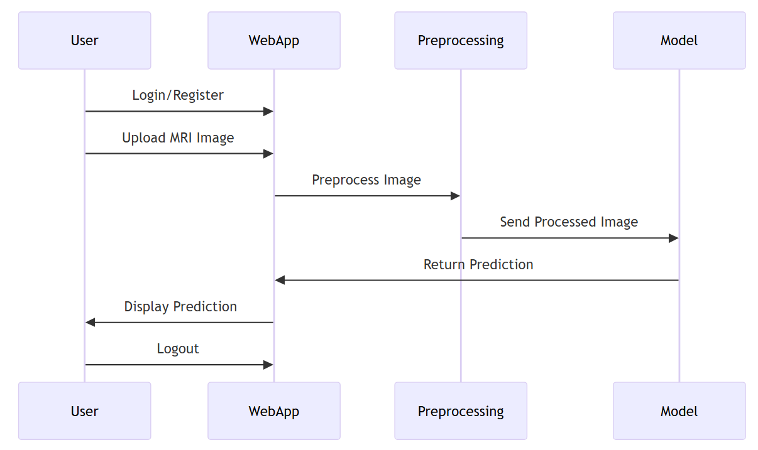
SEQUENCE DIAGRAM

Slide 25
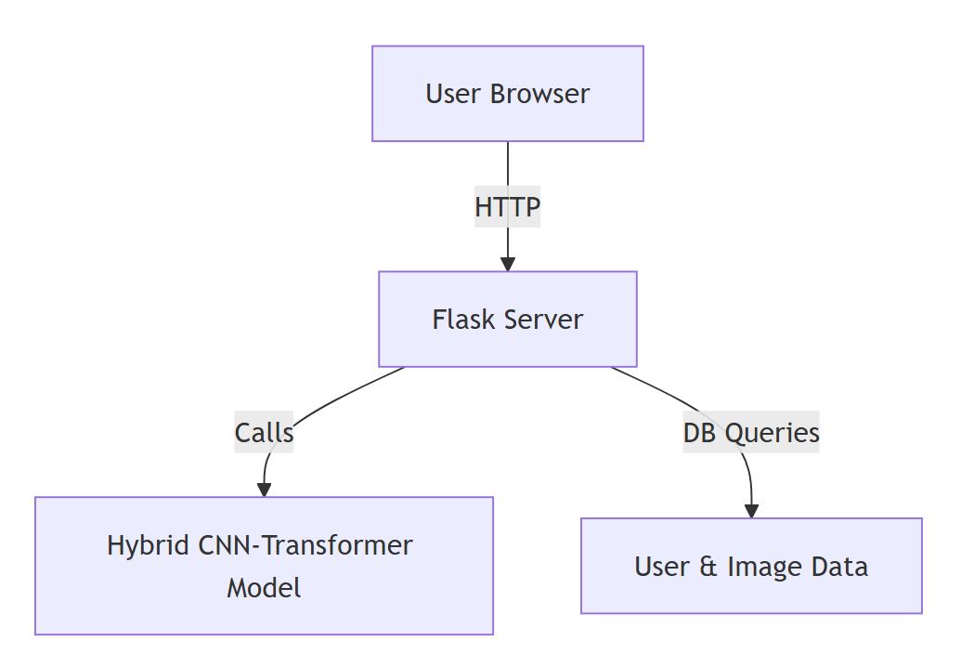
DEPLOYMENT DIAGRAM
A Deployment diagram, also known as a performance diagram, represents the physical performance of software components on hardware nodes. It shows how artifacts, such as executables and libraries, are distributed across hardware components and their relationships. This diagram helps in understanding the system's physical architecture and performance configuration.

Slide 26
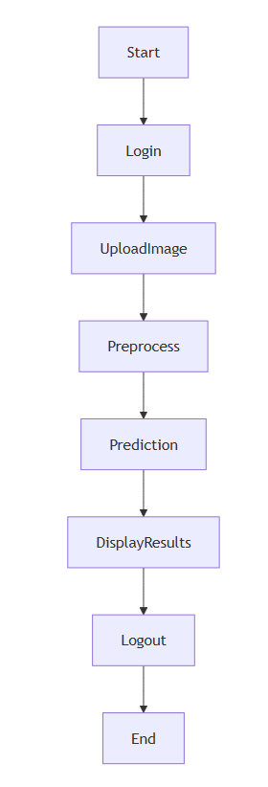
ACTIVITY DIAGRAM
An activity diagram is a behavioral diagram that illustrates the flow of control or data through a series of activities or actions in a system. It represents the dynamic aspects of a process, including decision points, parallel activities, and the sequence of operations. Activity diagrams are useful for modeling workflows and business processes.

Slide 27
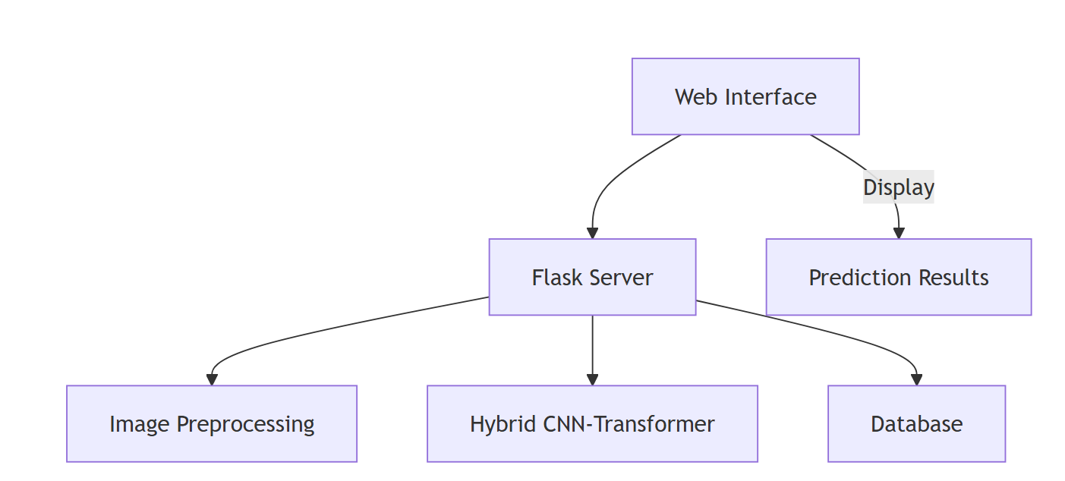
COMPONENT DIAGRAM
A component diagram is a structural diagram that depicts the physical components of a system and their dependencies. It shows how components, such as software packages or modules, are organized and interact with each other to form a complete system. This diagram helps in understanding the high-level structure and organization of the system's components.

Slide 28
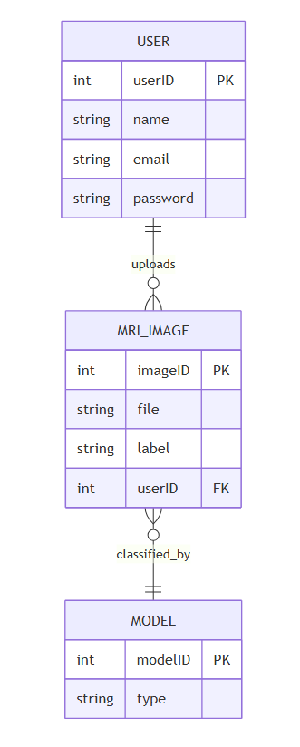
ER DIAGRAM
An Entity-Relationship (ER) diagram is a data model diagram that visually represents the entities, attributes, and relationships within a database. It shows how data entities interact with one another and the nature of their relationships, providing a blueprint for database design. ER diagrams are crucial for designing and understanding database schemas.

Slide 29
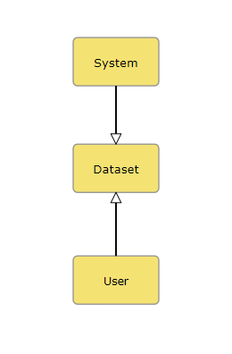
DFD DIAGRAM:
A Data Flow Diagram (DFD) is a traditional way to visualize the information flows within a system. A neat and clear DFD can depict a good amount of the system requirements graphically. It can be manual, automated, or a combination of both. It shows how information enters and leaves the system, what changes the information and where information is stored. The purpose of a DFD is to show the scope and boundaries of a system as a whole. It may be used as a communications tool between a systems analyst and any person who plays a part in the system that acts as the starting point for redesigning a system.
Contrast Level:

Slide 30
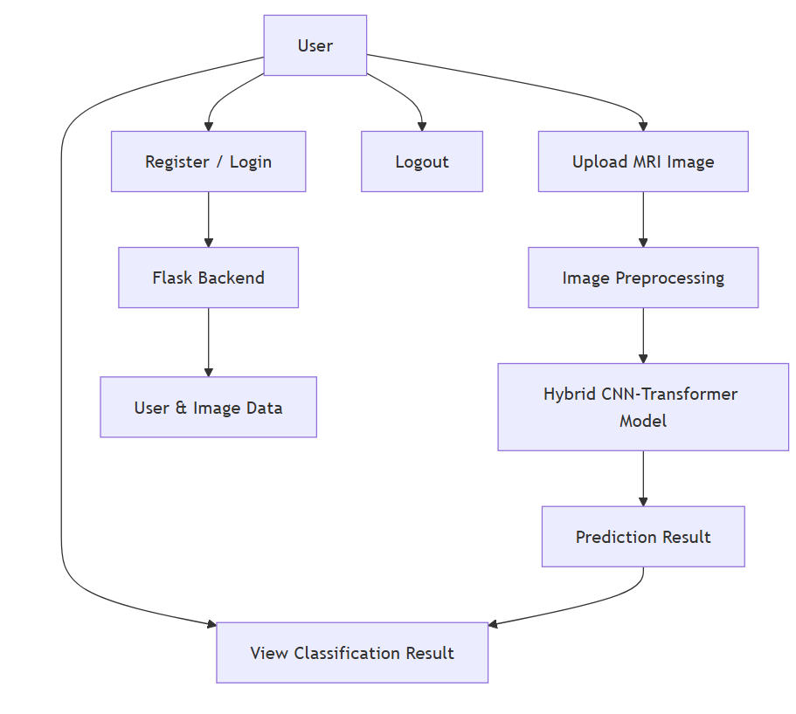
Level 1 Diagram:

Slide 31
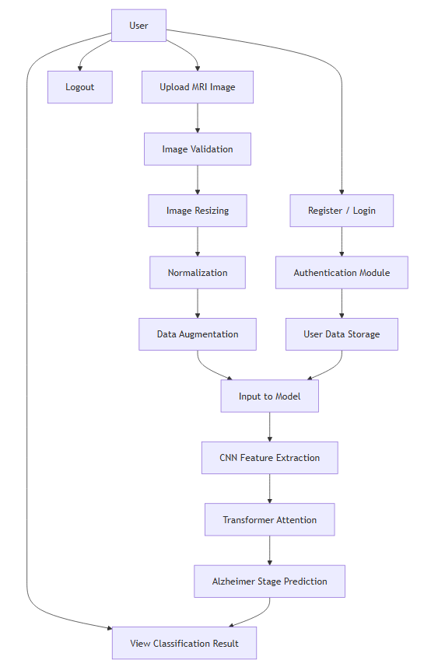
Level 2 Diagram:

Slide 32
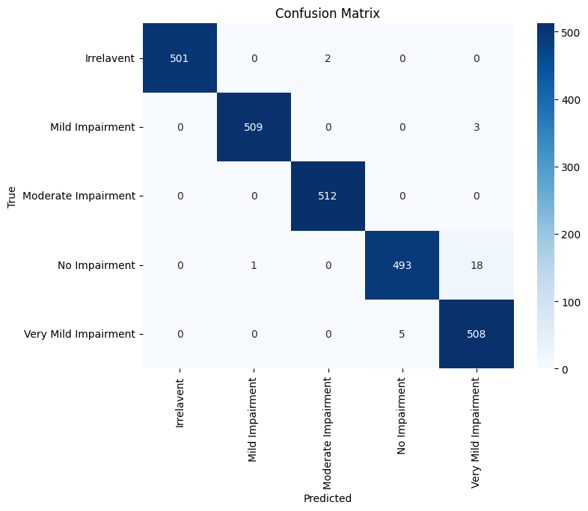
Results
Model Accuracy Highlights
High diagonal values indicate strong performance:
Irrelevant: 501/503 correctly predicted → 99.6%
Mild Impairment: 509/512 → 99.4%
Moderate Impairment: 512/512 → 100%
No Impairment: 493/512 → 96.3%
Very Mild Impairment: 508/513 → 99.0%
confusion matrix for (EfficientNet-B3 + Swin Transformer)

Slide 33
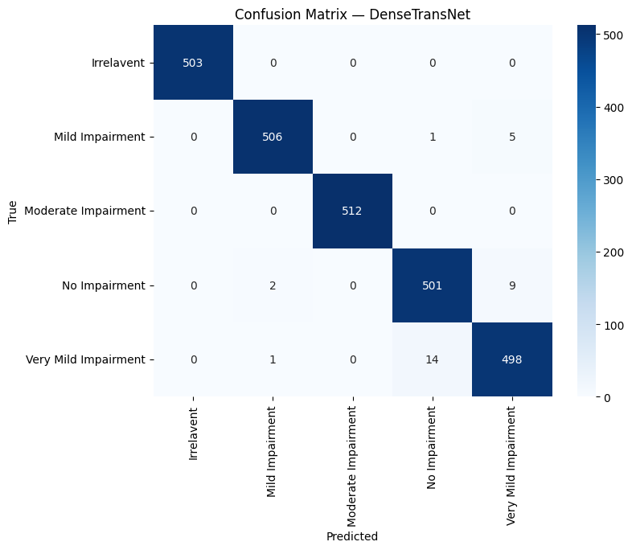
Results
Irrelevant: 500/500 → 100%
Mild Impairment: 506/512 → 98.8%
Moderate Impairment: 512/512 → 100%
No Impairment: 501/512 → 97.9%
Very Mild Impairment: 498/513 → 97.1%
Figure 2 confusion matrix for DenseNet-121 + Transformer Encoder

Slide 34

Results
Model Accuracy Highlights
Irrelevant: 503/503 → 100%
Mild Impairment: 497/512 → 97.1%
Moderate Impairment: 512/512 → 100%
No Impairment: 497/512 → 97.1%
Very Mild Impairment: 501/513 → 97.7%
Figure 3 CONFUSION MATRIX FOR (RESNET-50 + SWIN TRANSFORMER)

Slide 35
Conclusion:
The project, “Design of a CNN–Swin Transformer Model for Alzheimer’s Disease Prediction Using MRI Images,” successfully demonstrates an automated system for detecting and classifying Alzheimer’s disease stages. By integrating advanced CNN architectures such as EfficientNet-B3, ResNet-50,DenseNet-121 with attention-based Transformer models, the system effectively captures both local and global features from MRI images. The preprocessing steps, including resizing, normalization, and augmentation, improved the quality and consistency of the dataset, enabling the models to learn meaningful patterns efficiently.
The hybrid models were able to classify MRI images into five categories — No Impairment, Very Mild, Mild, Moderate, and Irrelevant — with high accuracy and reliability. The web-based interface developed using Flask allows users to upload MRI images, obtain predictions, and view results in a clear and interactive manner. The system also includes user registration, login, session management, and error handling, making it user-friendly and robust.

Slide 36
REFERENCES
Huang, Y., & Li, W. (2023). Resizer Swin Transformer‑Based Classification Using sMRI for Alzheimer’s Disease. Applied Sciences, 13(16), 9310. https://doi.org/10.3390/app13169310 (MDPI)
Jiaming Xin, Ancong Wang, Rui Guo, Weifeng Liu, & Xiaoying Tang. (2023). CNN and Swin‑Transformer based efficient model for Alzheimer’s disease diagnosis with sMRI. Biomedical Signal Processing and Control, 86, 105189. https://doi.org/10.1016/j.bspc.2023.105189 (Beijing Institute of Technology)
Abhishek Tiwari, Ananya Singhal, Saurabh J. Shigwan, & Rajeev Kumar Singh. (2024). Early Diagnosis of Alzheimer through Swin‑Transformer‑Based Deep Learning Framework using Sparse Diffusion Measures. Proceedings of the 15th Asian Conference on Machine Learning (PMLR 222:1369–1384). https://proceedings.mlr.press/v222/tiwari24a.html (Proceedings of Machine Learning Research)
Yanlei Wang, Hui Sheng, & Xueling Wang. (2025). Recognition and diagnosis of Alzheimer’s Disease using T1‑weighted magnetic resonance imaging via integrating CNN and Swin vision transformer. Clinics (Sao Paulo), 80, 100673. https://doi.org/10.1016/j.clinsp.2025.100673 (X-ray Interpreter)
Hassan Almalki, Alaa O. Khadidos, Nawaf Alhebaishi, & Ebrahim Mohammed Senan. (2025). Early detection of Alzheimer’s disease progression stages using hybrid of CNN and Transformer Encoder models. Scientific Reports, 15, 16799. https://doi.org/10.1038/s41598‑025‑01072‑5 (PMC)

Slide 37
REFERENCES
Muhammad Umair Ali, Kwang Su Kim, Majdi Khalid, Majed Farrash, Amad Zafar, & Seung Won Lee. (2024). Enhancing Alzheimer’s disease diagnosis and staging: a multistage CNN framework using MRI. Frontiers in Psychiatry, 15, 1395563. https://doi.org/10.3389/fpsyt.2024.1395563 (PMC)
Pranay Agarwal, Vikhyat Jagawat, B. Jathiswar, & M. Poonkodi. (2023). A deep learning framework for early diagnosis of Alzheimer’s disease on MRI images. Multimedia Tools and Applications, 83, 3767–3799. https://doi.org/10.1007/s11042-023-15738-7 (SpringerLink)
Murat Avşar & Kemal Polat. (2023). Classifying Alzheimer’s disease based on a convolutional neural network with MRI images. Journal of Artificial Intelligence and Systems, 5, 46–57. https://doi.org/10.33969/AIS.2023050104 (iecscience.org)
Juan Zhou, Yiming Wei, Xiong Li, Weiqiang Zhou, Ruiyang Tao, Yi Hua, & Hongwei Liu. (2025). A deep learning model for early diagnosis of Alzheimer’s disease combined with 3D CNN and video Swin Transformer. Scientific Reports, 15, 23311. https://doi.org/10.1038/s41598‑025‑? (Jul 02 2025) (Life Science Network)
Saddam Hussain Khan. (2024). A Novel Feature Map Enhancement Technique Integrating Residual CNN and Transformer for Alzheimer Diseases Diagnosis. arXiv preprint arXiv:2405.12986. https://arxiv.org/abs/2405.12986 (arXiv)

